Slide 1

Network Security 2: Protocol subversion, system connections, and boundaries

Slide 2
Let’s see what a network looks like:
Networks communicate using protocols
Let’s look at 3 basic connection methods
Telnet, Secure Shell, Transportation Layer Security
A few issues with these
Then TCP and HTTP
To include HTTPS

Slide 3
Protocols
Protocols are translators
They are an established set of rules that govern how data is transmitted between different devices within a network
Define: Format, Msg Order (send/receive), Actions taken on msg send or receipt
Our Apple which speaks MacOS and our server which speaks Linux are able to communicate and upload a file using a protocol (FTP) and the same protocol allows the Server to talk to a Windows 10 (Powershell) machine which needs to download the file.
They are standards created by IT organizations like IEEE or W3C
Notes:
On board: Draw stick figures. Human protocols – the icebreaker & typical (hopefully there will be variance but if not ask how it might be different if your meeting a new co-worker vs. family member’s new significant other vs. new professor….). Should have rules (algorithm) directing actions.

Slide 4

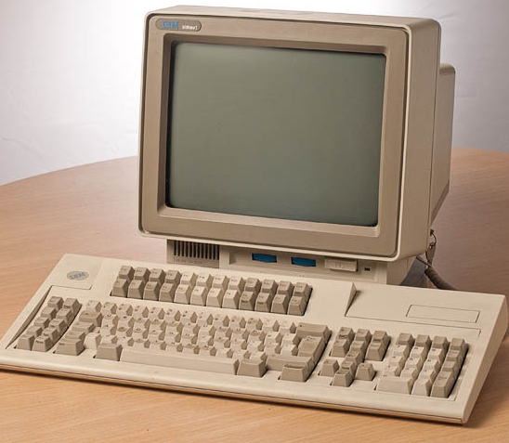
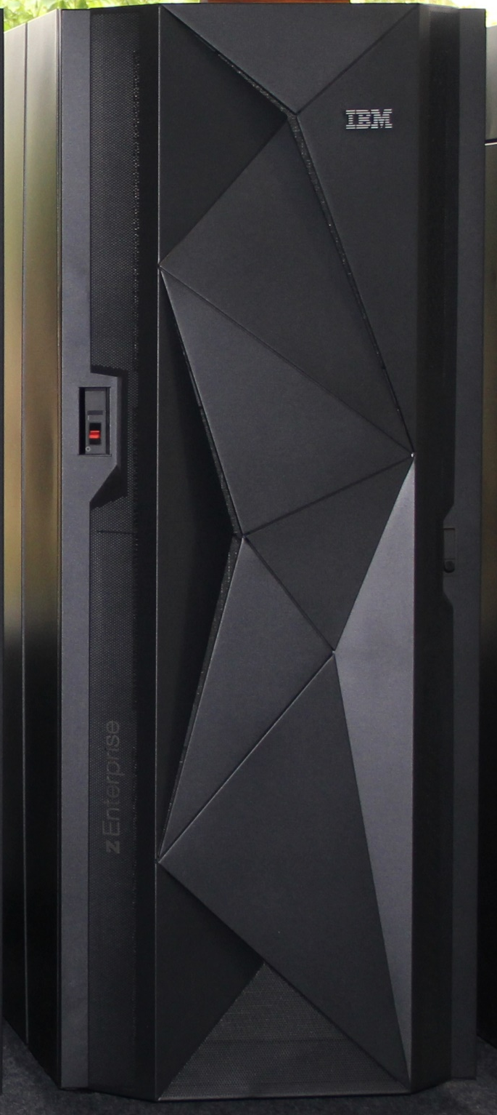
Mainframe Example
Remind you of anything?
Mainframes are rarely used anymore but they were all the rage until the late 90s. The principles used with mainframes still form a foundation upon which later topographies were built:
Telnet
Dummy terminals: Remote connect to Mainframe to run
Telnet software emulates a terminal
Mainframe holds main OS

Slide 5

It’s a pretty famous example

Slide 6
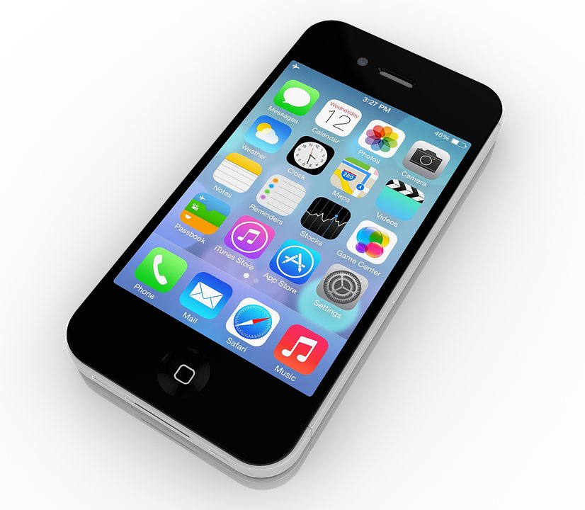

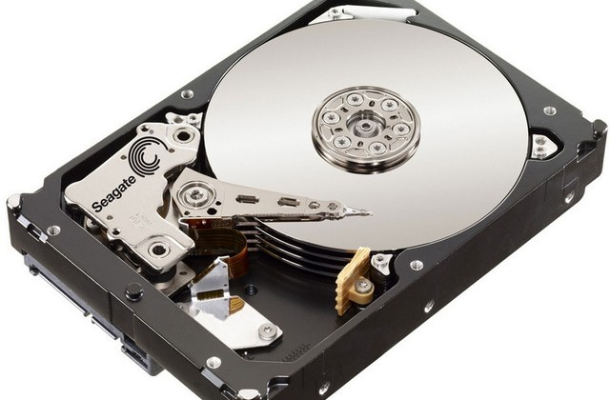

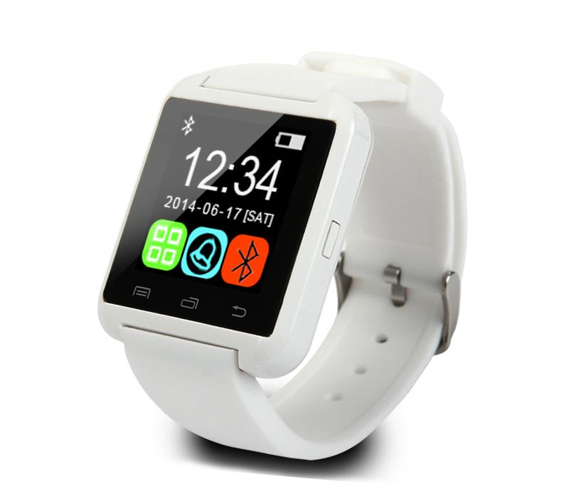
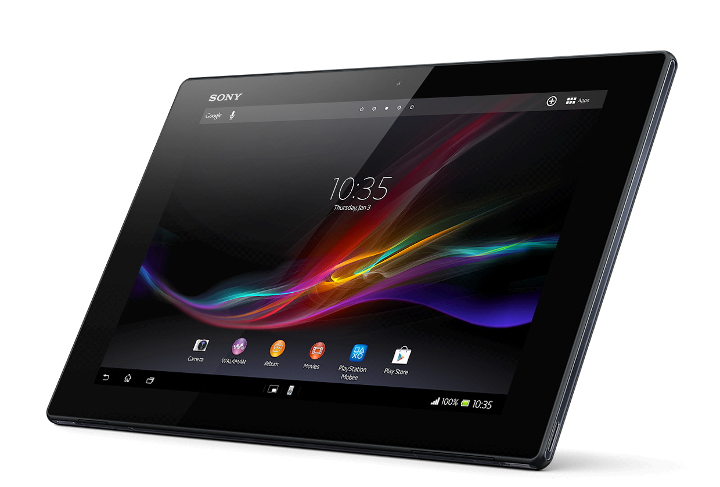
HTTP
Cloud Drive (simplified)
This Photo by Unknown Author is licensed under CC BY-SA
This Photo by Unknown Author is licensed under CC BY-SA-NC
This Photo by Unknown Author is licensed under CC BY-NC-ND

Slide 7

Problem with Telnet & HTTP
It was plain text – really that was the big issue (and was a big one at that)
This means they can be re-routed – because we cannot really verify who is receiving
2008 YouTube taken down (all of it) because Pakistan tried to censor it
Made their ISPs pass out fake routes for all YouTube traffic so they could intercept and censor.
False roots were cached by YouTube (common practice) and used for global traffic (by YouTube’s own Border Gateway Protocols)
As routes didn’t actually go anywhere – wrong path = no Youtube
2010 China Telecom down for 18 minutes (the whole nation) because of 10000 invalid routes (15% of addresses)
Some intelligence agency did this by advertising that many false routes through their BGP (not sure which)

Slide 8
Let’s relook at the earlier examples
And add some security

Slide 9
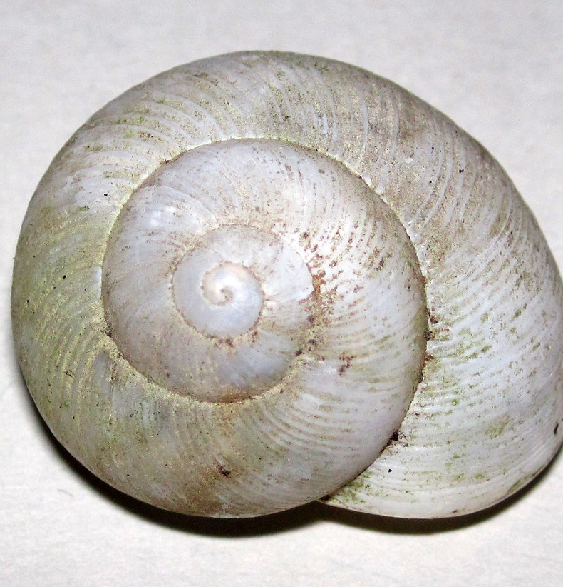
Why SSH?
Early technology had no confidentiality or integrity
Telnet and FTP transmit username and passwords in cleartext
This makes them vulnerable to:
IP Spoofing (similar to earlier – you just give a fake IP address over full fake gateway)
Man in the Middle (MitM, setup fake gateway)
Eavesdropping (sniff traffic to find info)
SSH prevents this with:
Data Encryption (confidence)
Host/Client-based authentication
Hash (table) based address matching (MAC/IP) (integrity)
Older encryption models added encryption but no integrity
Still some MitM
This Photo by Unknown Author is licensed under CC BY

Slide 10
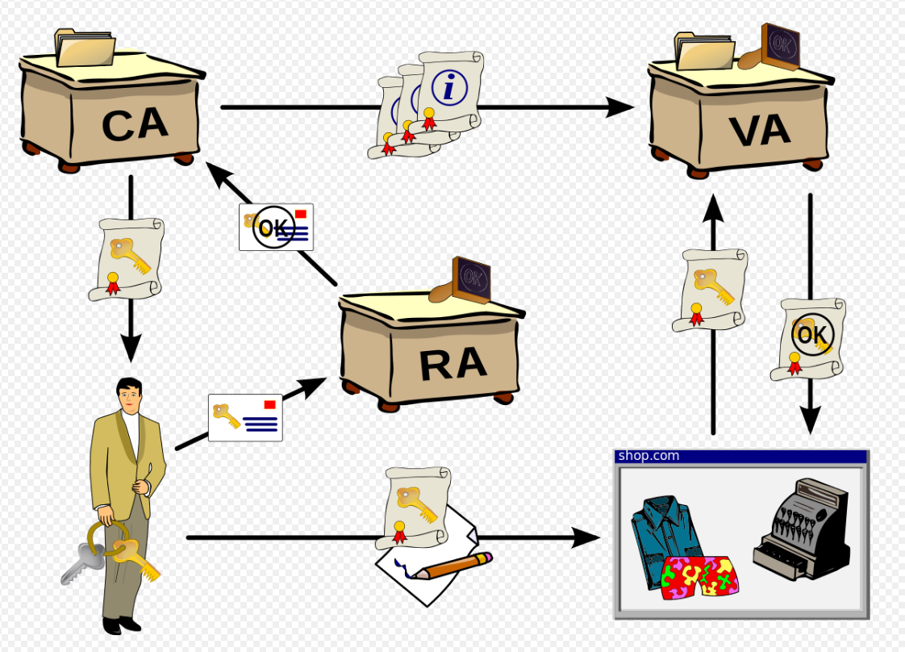
One solution
Public Key Infrastructure (PKI)
1970s….released to public in 1990s
We’ll cover what they are in Encryption portion
Then Decentralized PKI
Standard uses a centralized registry of identifiers (from a certification authority)
Decentralized removes this and uses a distributed ledger with each entity serving as its own root authority
The second is becoming increasingly popular but that’s a different class
Why does this help solve the problem (either version)?

Slide 11
SSH protocol Exchange (note: no SSL)
Client
Server
Opens a TCP connection to port 22
SSH protocol version exchange
e.g ASCII :” SSH-1.5-1.2.27”
Server identification {H+S+list of ciphers and authentication methods+cookie} + session parameters
Selected data cipher +encrypted session key K(H,S) +cookie
Server acknowledgement encrypted with K
Secure connection established!
Server authenticated

Slide 12
Two types of SSH (okay…3)
SSH-1: older and no longer supported
SSH-2: Fixes bugs in SSH-1 and adds security. Version used on Windows 10+ & MS Server machines.
OpenSSH: Runs on SSH-2 and is the free version used in *nix environments (and most windows environments).
Allows for full VPN instead of just and SSH tunnel depending on configuration

Slide 13
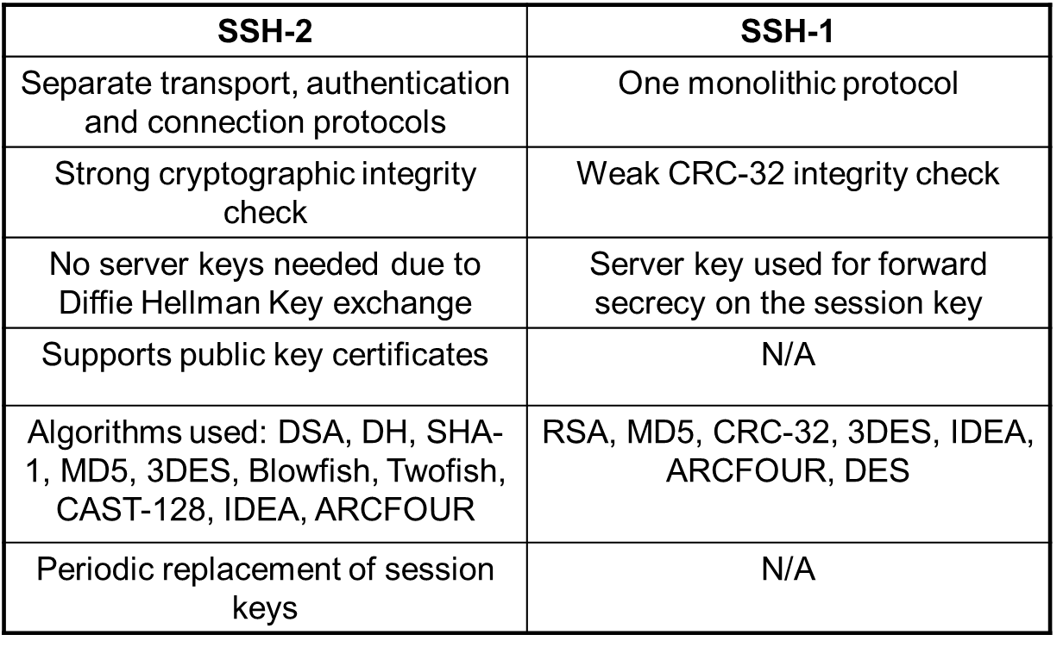
Differences between 1 & 2

Slide 14
SSH protections & Issues What do you think they are?
SSH protects against:
Some Eavesdropping and MITM
Encryption, Periodic Key Replacements
Connection hijacking
strong encryption integrity check
Periodic Session Key replacements
Name service and IP spoofing
strong encryption integrity check
certification
Does not work (can help) against:
Password cracking (keys help)
Malicious Threat Actors
Insider Actors

Slide 15

A Known security issue with SSH-1 (also 2)
This one was just fixed (called the “GOBBLES” exploit) but tended to just crash servers (this is a nutshell explanation):
Standard SSH session started
Standard info_request prompts
Attacker sends a huge integer instead of requested number of responses
Integer gets written to all pointers in the array eventually causing overflow errors

Slide 16
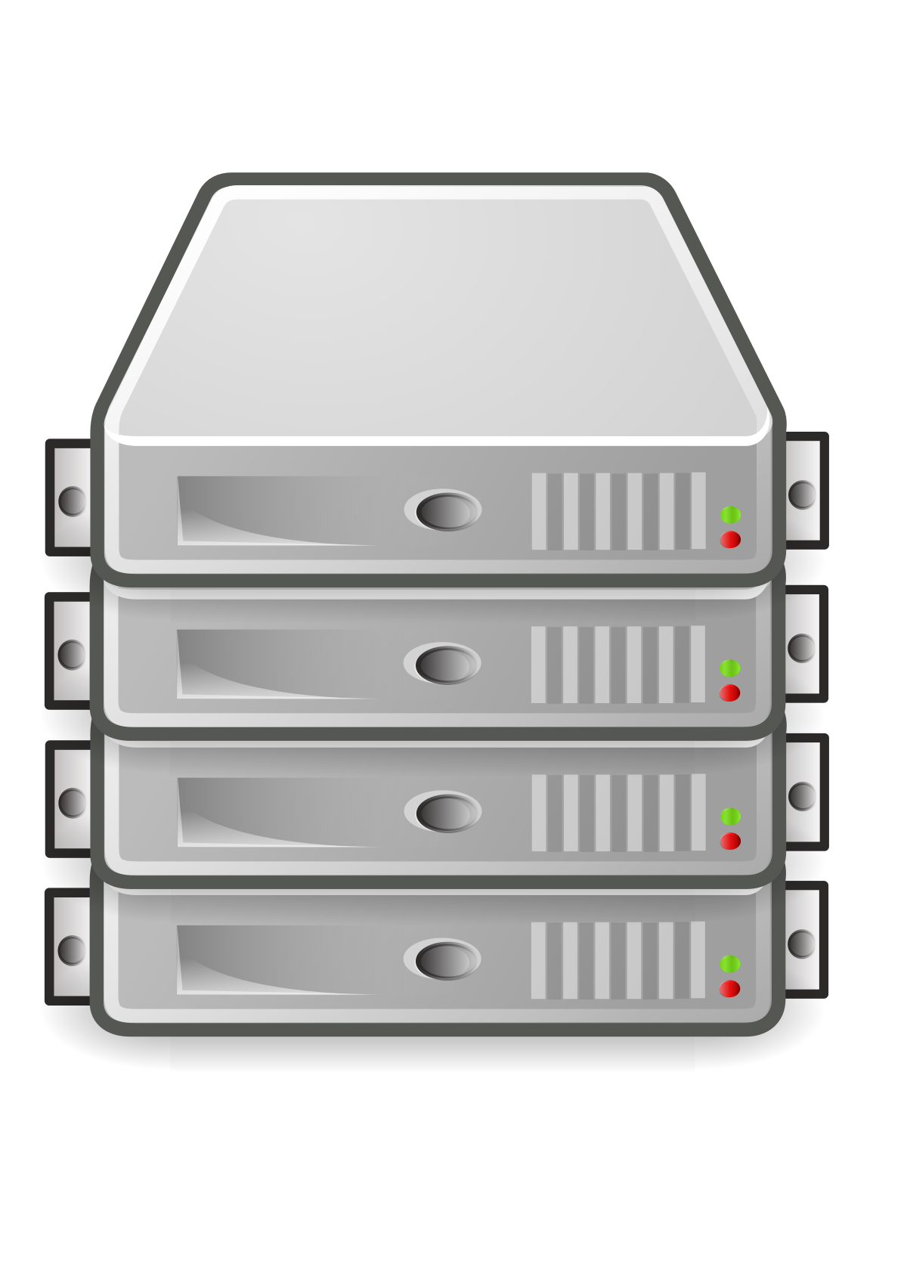
So we can have a network in a network (web server)
This Photo by Unknown Author is licensed under CC BY-NC-ND
This Photo by Unknown Author is licensed under CC BY-SA
This Photo by Unknown Author is licensed under CC BY-SA

Slide 17
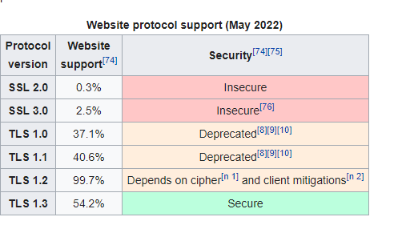
What is HTTP?
It’s a protocol used for the Internet; defines that a client creates a request (defines this too) and a server should respond (this too)
HTTP = Hypertext Transfer Protocol
HTTPS = Hypertext Transfer Protocol using Security (this is Transport Layer not Protocol)
Used to be SSL (Secure Socket Layer, 94) now is TLS (Transport Layer Security, 2016)
June 15, 22: Last SSL based browser died

Slide 18
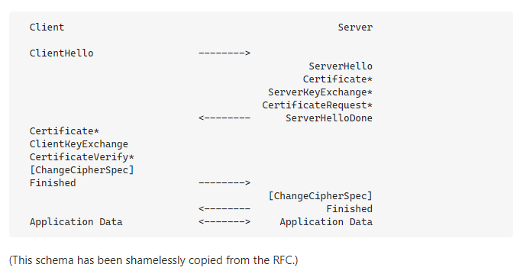

Slide 19
So what happened on Google’s end?
A Google webserver (at address ….) received an HTTPS request on port 443
It decided on this server because it has virtual hosting (see reading) which allows it to assign multiple end-points for a single URL
It processed it using the defined rules of the protocol and standard TLS validation with a GET request
There were not passed arguments
It’s internal rules specified if www.google.com with no arguments then return index.html
Verify
We downloaded the returned index.html from the open communication network and the browser automagically processed it

Slide 20
That was a lot – and its just the surface
We’ll continue this next week
This week, look at your project (and its platform) and how might some of these change the SWOT you did?

